Slide 1

Chapter 13 Wired LANs: Ethernet
13.1
Copyright © The McGraw-Hill Companies, Inc. Permission required for reproduction or display.

Slide 2
13--11 IIEEEEEE STAANNDDAARRDDSS
In 1985,,,, the Computer Society of the IEEE started a project, ccaalllleedd PPrroojjeecctt 880022,, ttoo sseett ssttaannddaarrddss ttoo eennaabbllee intercommunication among equipment from a variety of mmaannuuffaaccttuurreerrss.. PPrroojjeecctt 880022 iiss a wwaayy ooff ssppeecciiffyyiinngg functions of the physical layer and the data link layer of mmaajjoorr LLAANN pprroottooccoollss.
Topics discussed in this section:
Data Link Layer Physical Layer

Slide 3
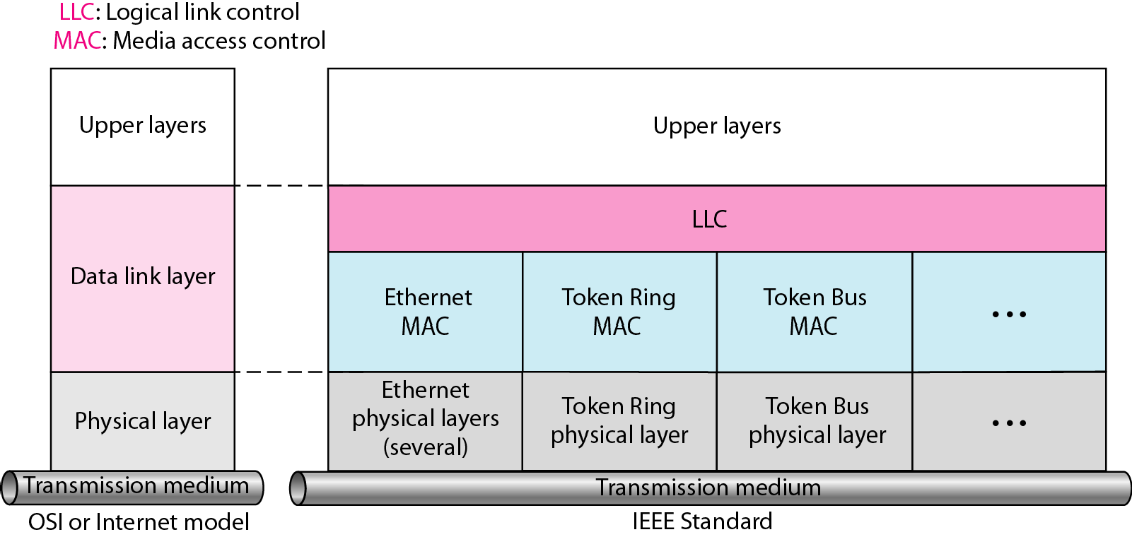
Figure 13.1 IEEE standard for LANs

Slide 4
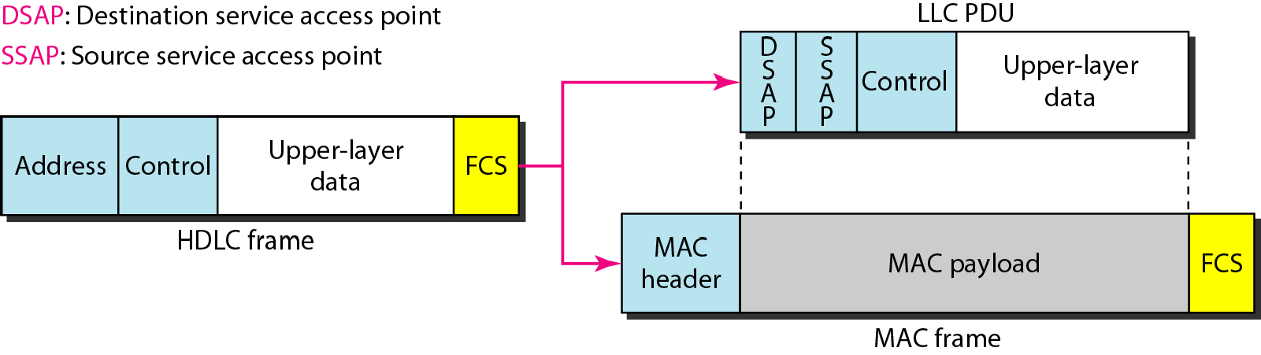
Figure 13.2 HDLC frame compared with LLC and MAC frames

Slide 5
13--22 STANDARD ETHERNET
The original Ethernet was created in 1976 at Xerox’s Palo AAllttoo RReesseeaarrcchh CCeenntteerr ((PPAARRCC)).. SSiinnccee tthen, iitt hhaass gone through four generations.. We briefly discuss the Standard ((oorr ttrraaddiittiioonnaall)) EEtthheerrnneett in tthhiiss sseeccttiioonn..
Topics discussed in this section:
MAC Sublayer Physical Layer

Slide 6
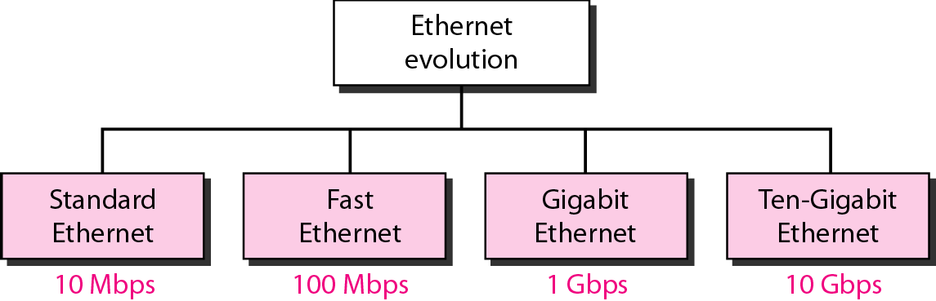
Figure 13.3 Ethernet evolution through four generations

Slide 7
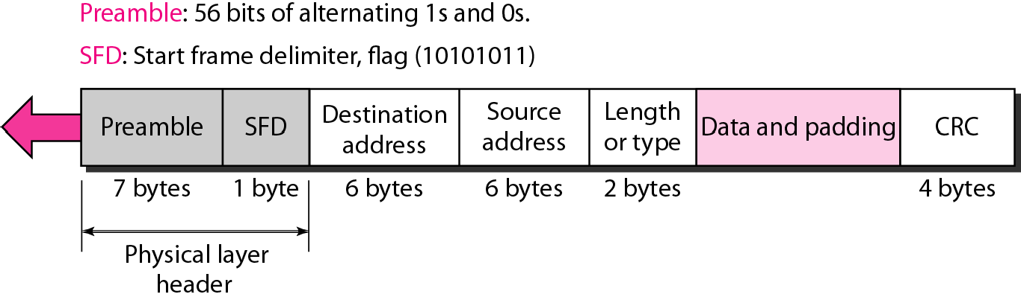
Figure 13.4 802.3 MAC frame

Slide 8
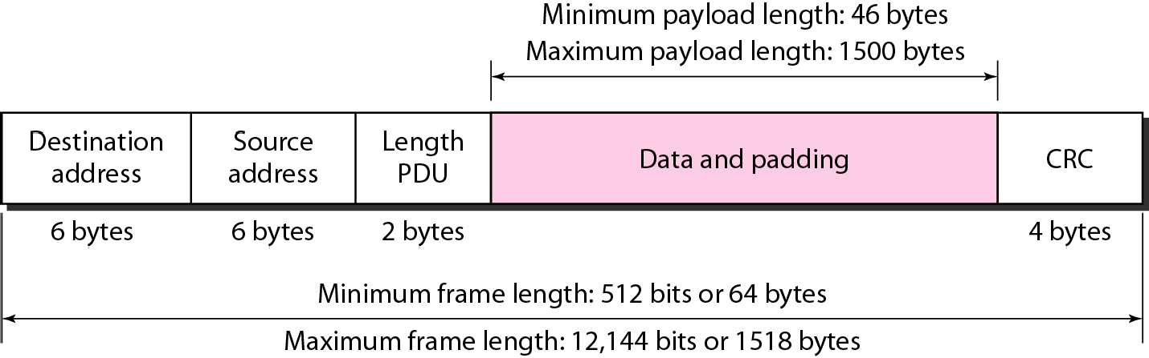
Figure 13.5 Minimum and maximum lengths

Slide 9

Note
Frame length: Minimum: 64 bytes (512 bits)
Maximum: 1518 bytes (12,144 bits)

Slide 10
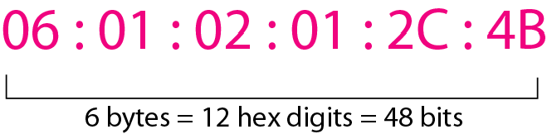
Figure 13.6 Example of an Ethernet address in hexadecimal notation

Slide 11
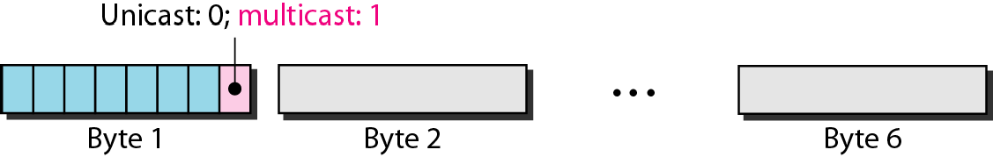
Figure 13.7 Unicast and multicast addresses

Slide 12
Note
The least significant bit of the first byte defines the type of address.
If the bit is 0, the address is unicast; otherwise, it is multicast.

Slide 13
Note
The broadcast destination address is a special case of the multicast address in which all bits are 1s.

Slide 14
Example 13.1
Define the type of the following destination addresses:
a 4A:30:10:21:10:1
c. FF:FF:FF:FF:FF:FF
Solution
b 47:20:1B:2E:08:EE
To find the type of the address, we need to look at the second hexadecimal digit from the left. If it is even, the address is unicast. If it is odd, the address is multicast. If all digits are F’s, the address is broadcast. Therefore, we have the following:
This is a unicast address because A in binary is 1010.
This is a multicast address because 7 in binary is 0111.
This is a broadcast address because all digits are F’s.

Slide 15
Example 13.2
Show how the address 47:20:1B:2E:08:EE is sent out on line.
Solution
The address is sent left-to-right, byte by byte; for each byte, it is sent right-to-left, bit by bit, as shown below:

Slide 16
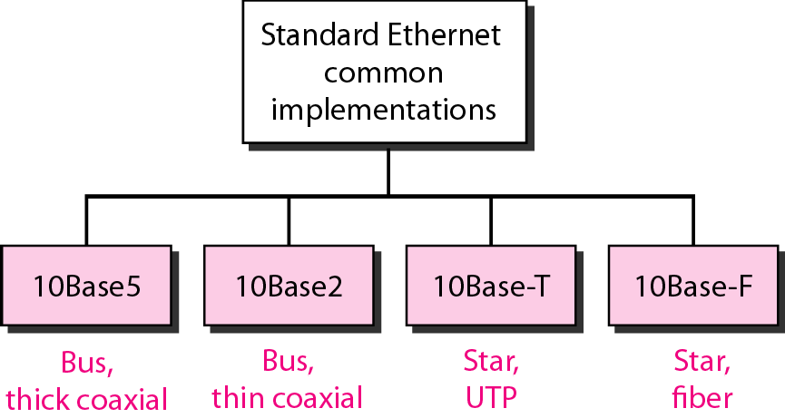
Figure 13.8 Categories of Standard Ethernet

Slide 17
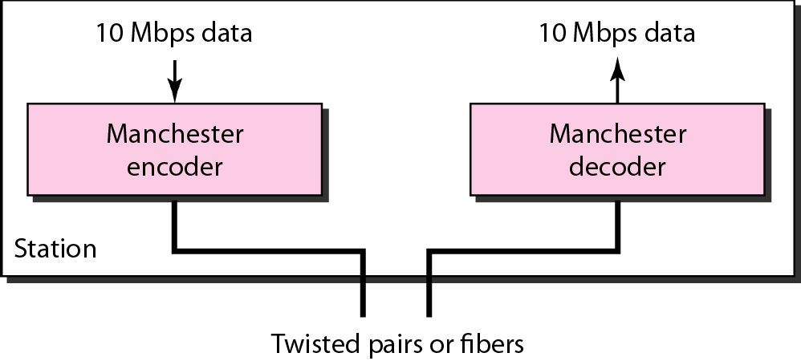
Figure 13.9 Encoding in a Standard Ethernet implementation

Slide 18
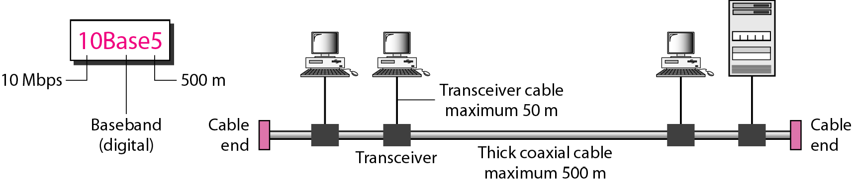
Figure 13.10 10Base5 implementation

Slide 19
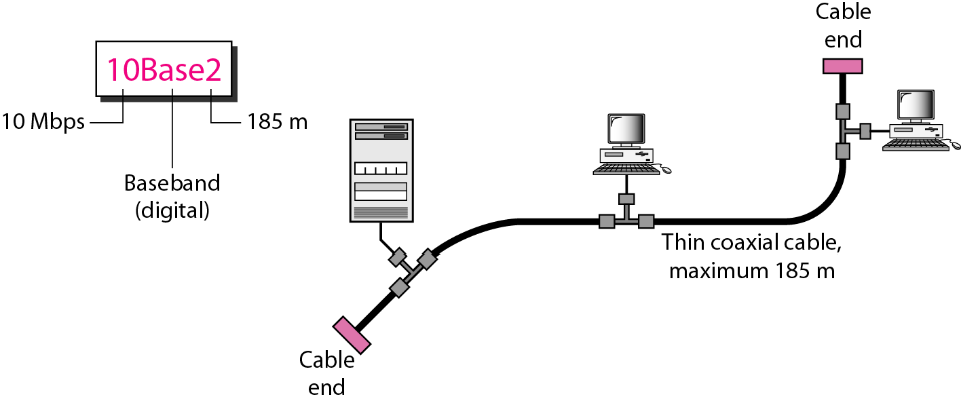
Figure 13.11 10Base2 implementation

Slide 20
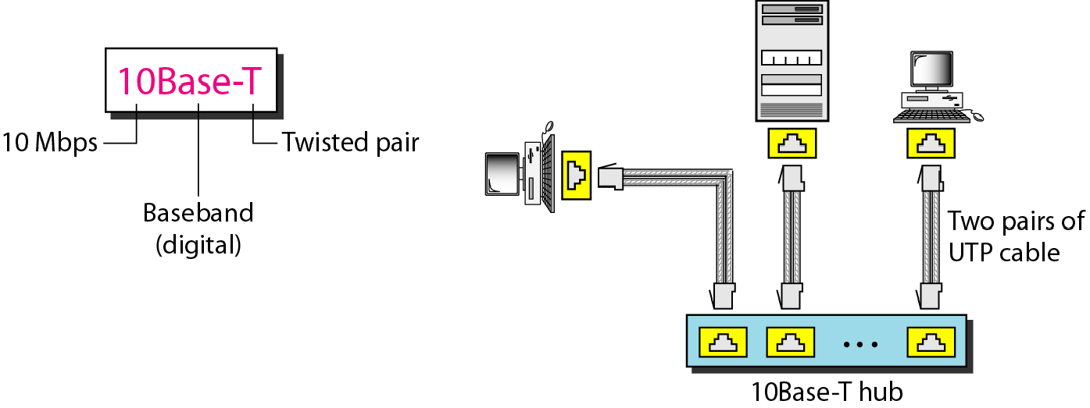
Figure 13.12 10Base-T implementation

Slide 21
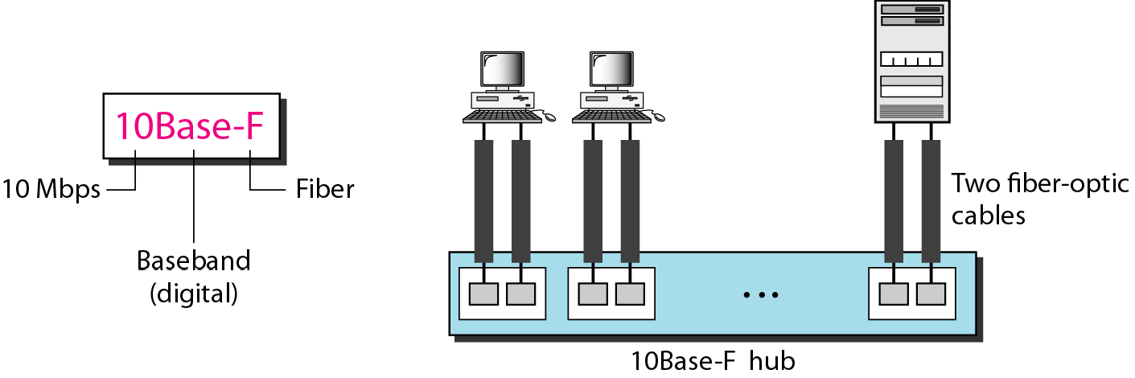
Figure 13.13 10Base-F implementation

Slide 22
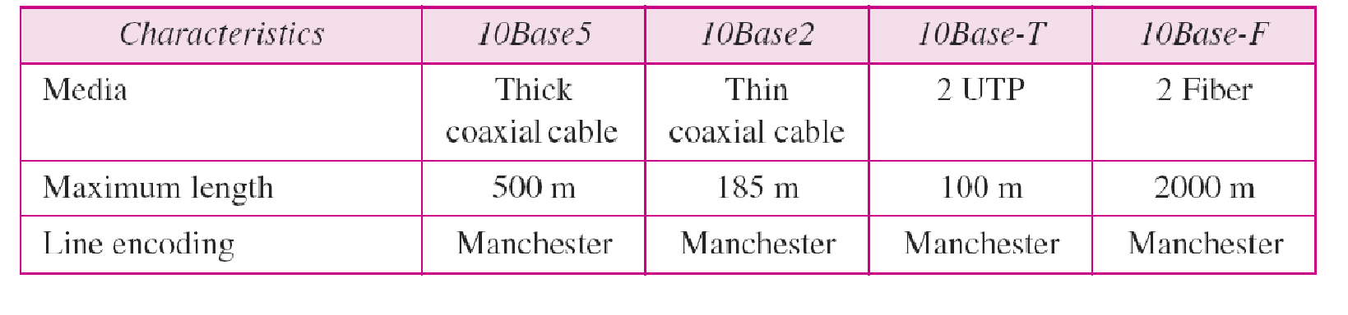
Table 13.1 Summary of Standard Ethernet implementations

Slide 23
13--33 CHANGES IN THE STANDARD
The 10-Mbps Standard Ethernet has gone through several cchhaannggeess bbeeffoorree mmoovviinngg ttoo tthhee hhiigghheerr ddaattaa rates.. These changes aacctually opened the road to the evolution oof tthhee EEtthheerrnneett ttoo bbeeccoommee ccoommppaattiibbllee wwiitthh other high-data--rraate LANs..
Topics discussed in this section:
Bridged Ethernet Switched Ethernet Full-Duplex Ethernet

Slide 24
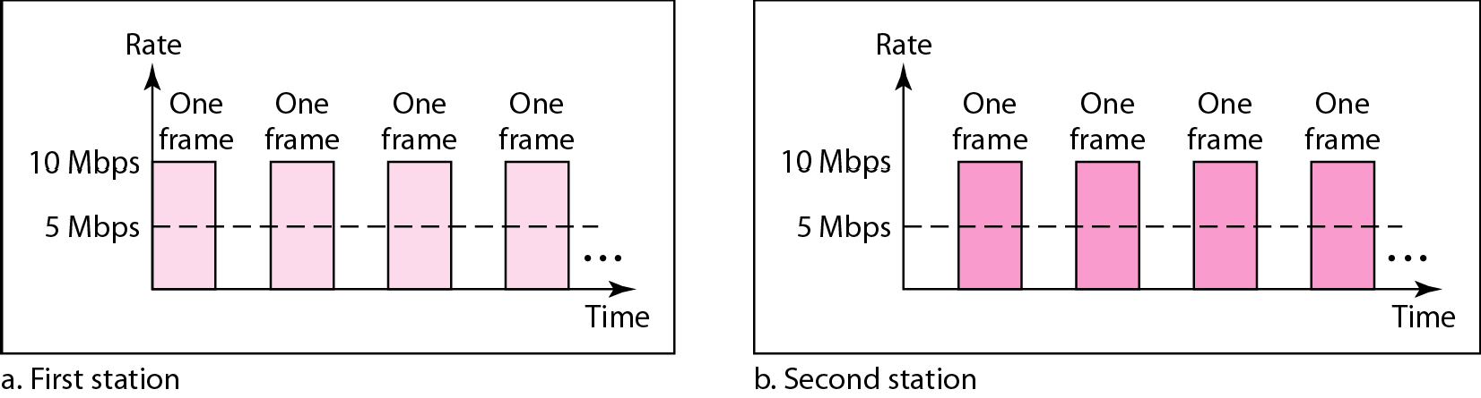
Figure 13.14 Sharing bandwidth

Slide 25
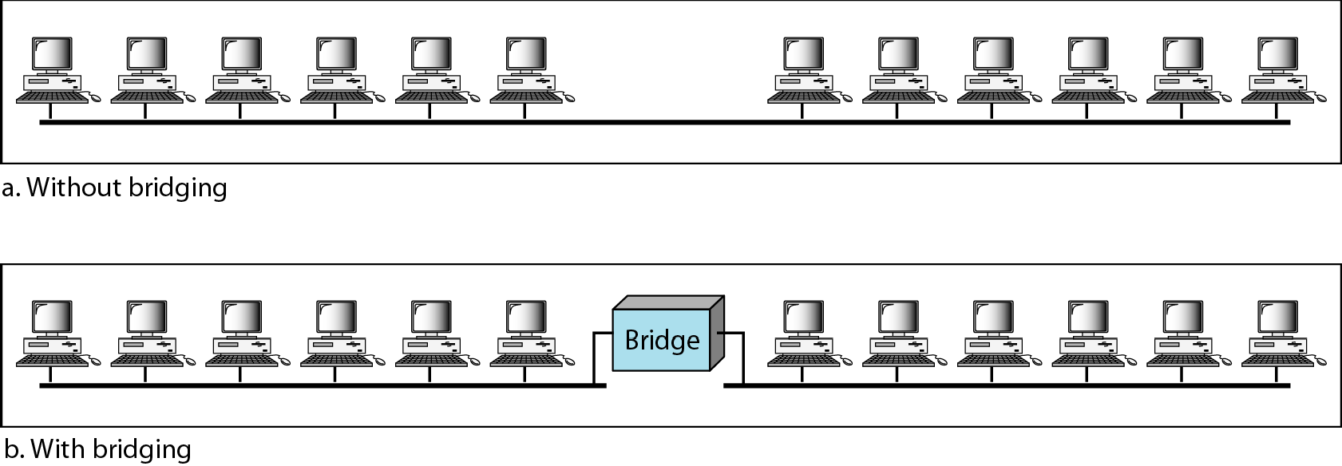
Figure 13.15 A network with and without a bridge

Slide 26
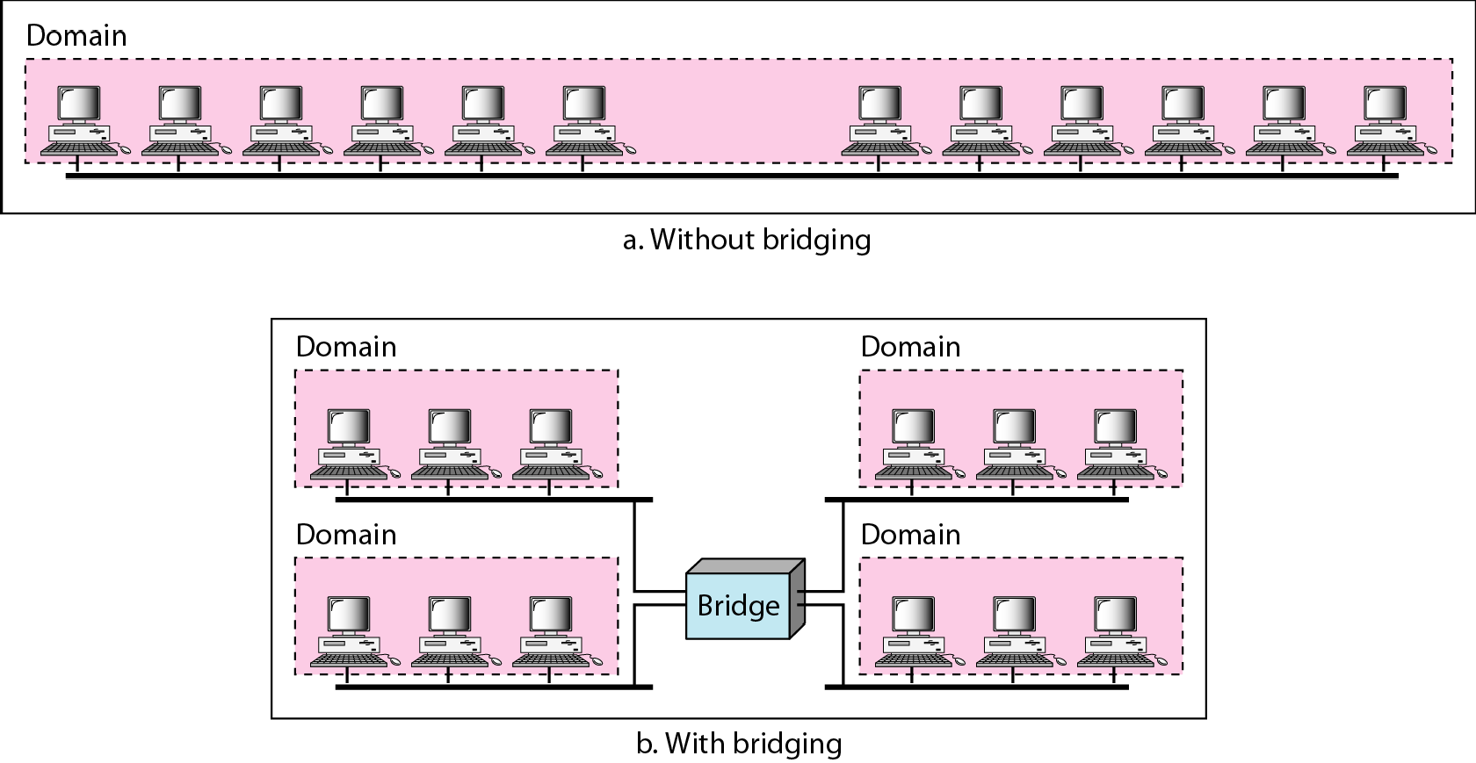
Figure 13.16 Collision domains in an unbridged network and a bridged network

Slide 27
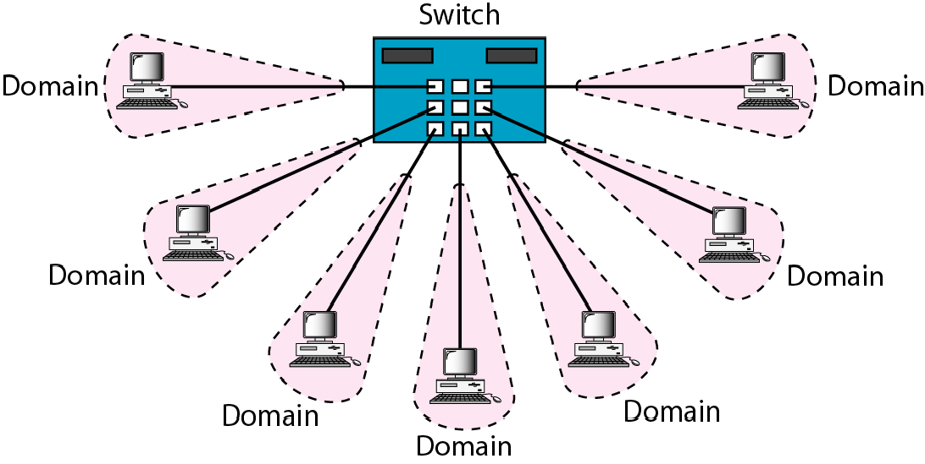
Figure 13.17 Switched Ethernet

Slide 28
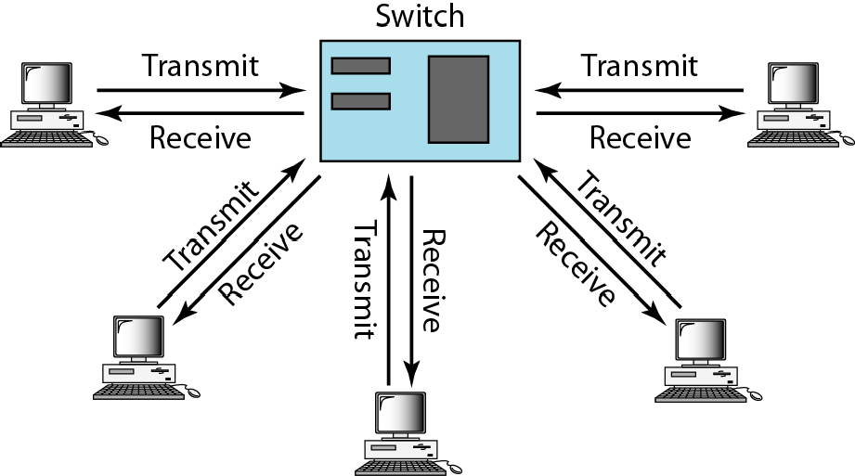
Figure 13.18 Full-duplex switched Ethernet

Slide 29
13--44 FAST ETHERNET
Fast Ethernet was designed to compete with LAN protocols ssuucchh aass FDDI oorr Fiber CChhaannnneell.. IIEEEEEE created Fast Ethernet under the name 802..3u.. Fast Ethernet iiss bbaacckkwwaarrdd--ccoommppaattiibbllee wwiitthh SSttaannddaarrdd Ethernet, but it can transmit data 10 times faster at a rate ooff 110000 MMbbppss..
Topics discussed in this section:
MAC Sublayer Physical Layer

Slide 30
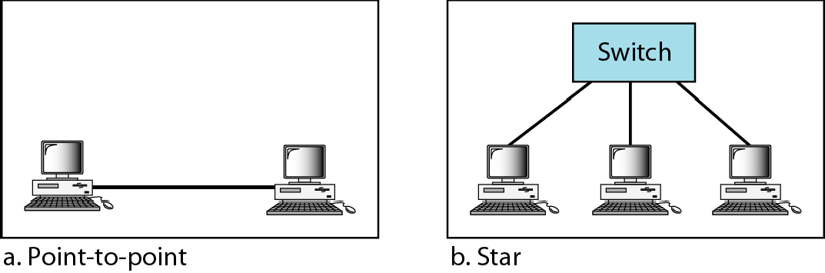
Figure 13.19 Fast Ethernet topology

Slide 31
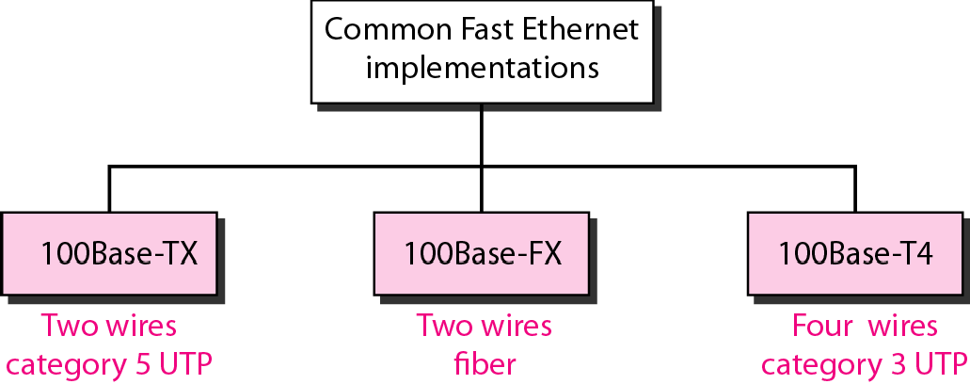
Figure 13.20 Fast Ethernet implementations

Slide 32
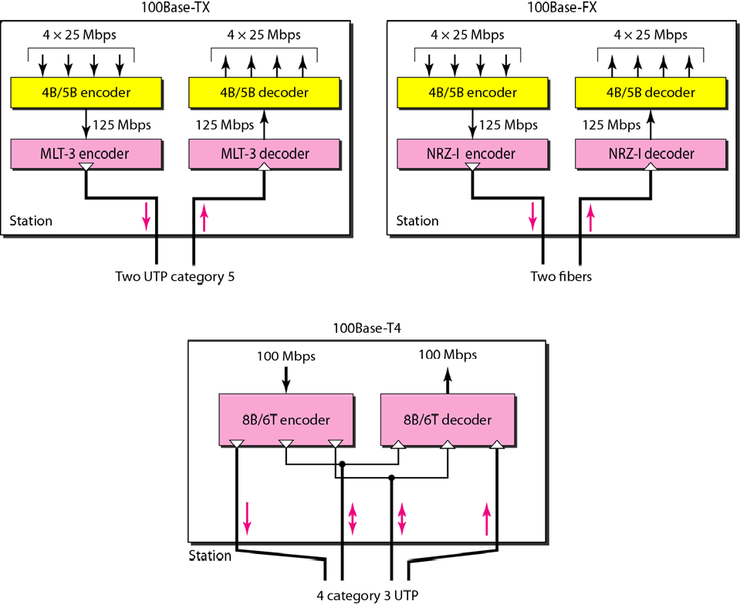
Figure 13.21 Encoding for Fast Ethernet implementation

Slide 33
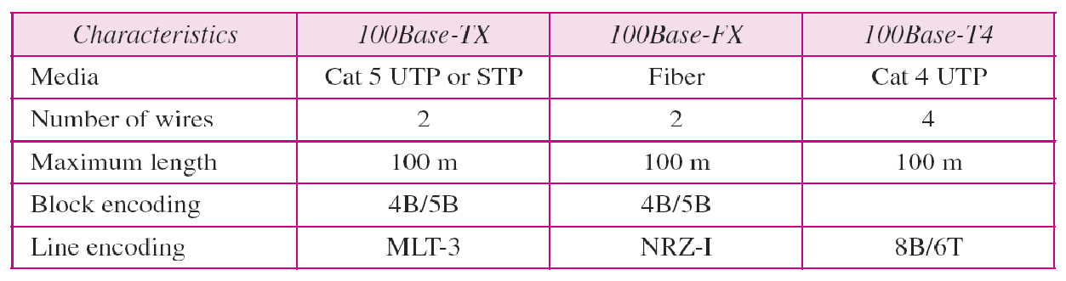
Table 13.2 Summary of Fast Ethernet implementations

Slide 34
13--55 GIGABIT ETHERNET
The nneeed for an eevveenn higher data rraate rreessuulted in the design ooff tthhee GGiiggaabbiitt EEtthheerrnneett protocol ((11000000 MMbbppss)).. The IEEE committee ccaalls the standard 802..3z..
Topics discussed in this section:
MAC Sublayer Physical Layer
Ten-Gigabit Ethernet

Slide 35

Note
In the full-duplex mode of Gigabit Ethernet, there is no collision;
the maximum length of the cable is determined by the signal attenuation in the cable.

Slide 36
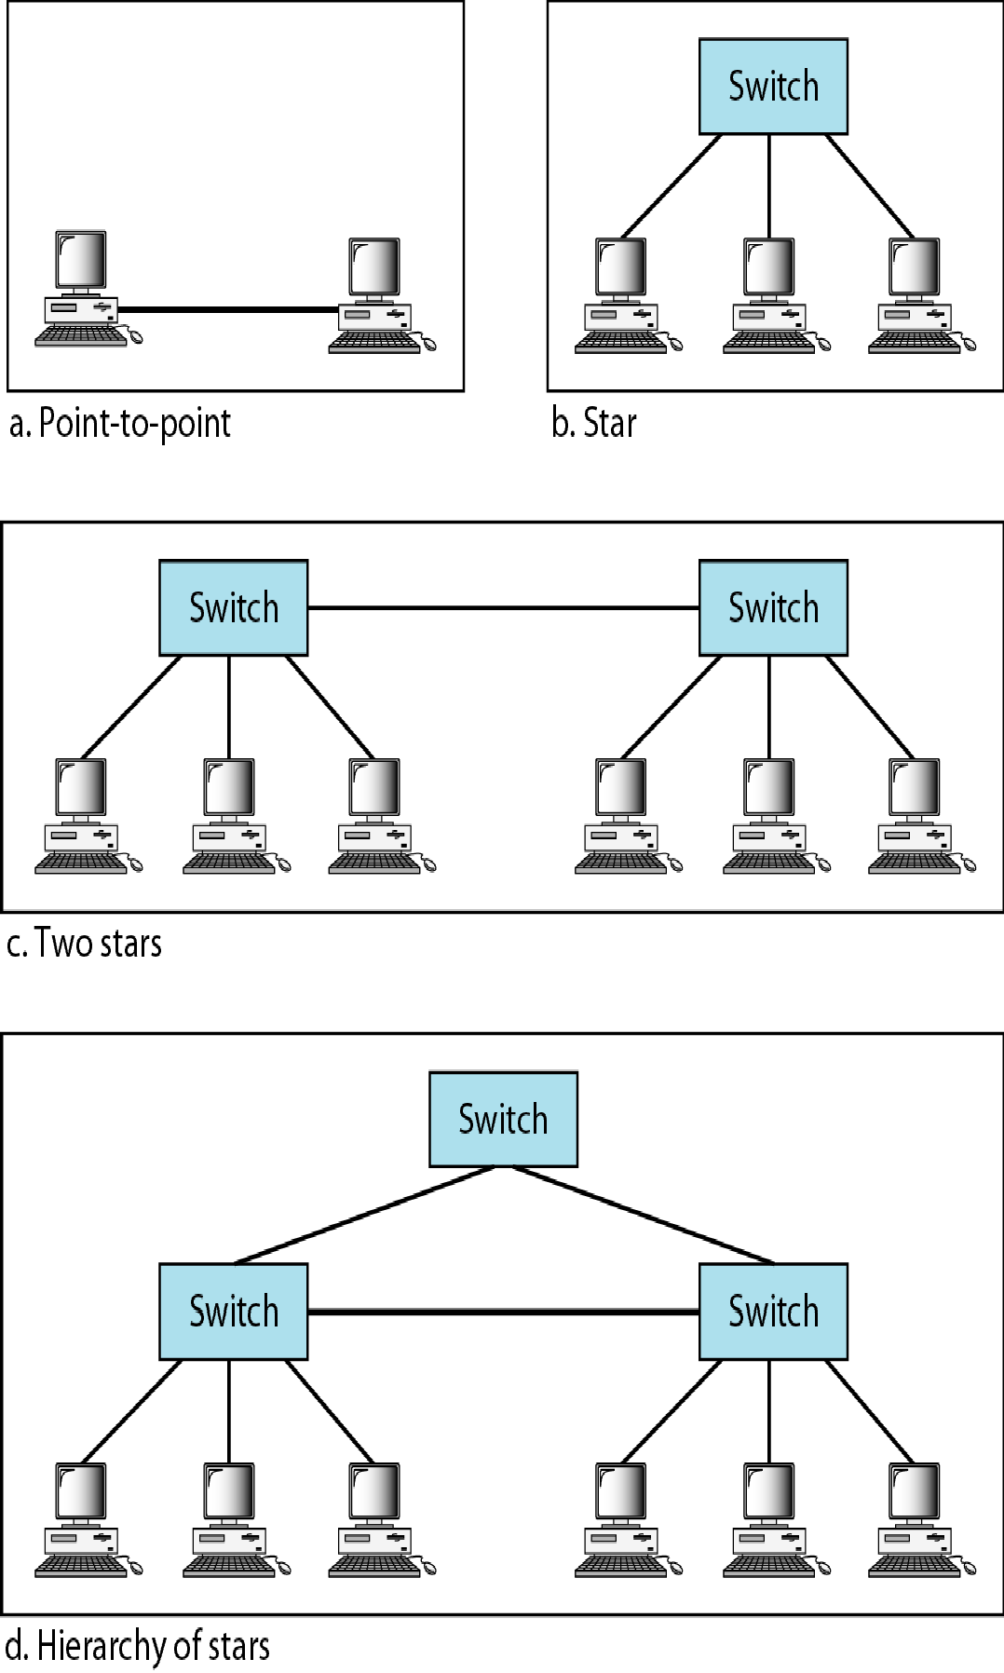
Figure 13.22 Topologies of Gigabit Ethernet

Slide 37
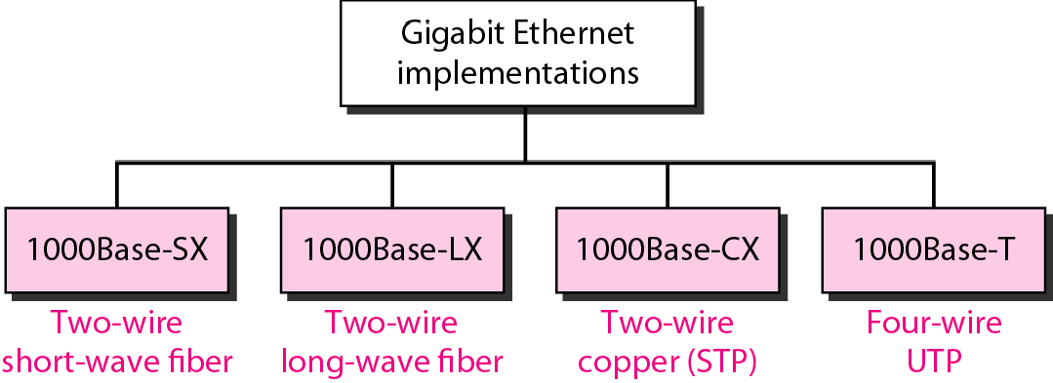
Figure 13.23 Gigabit Ethernet implementations

Slide 38
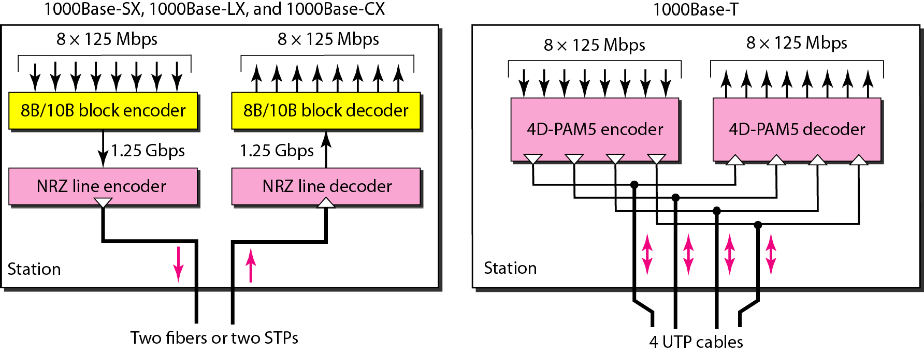
Figure 13.24 Encoding in Gigabit Ethernet implementations

Slide 39
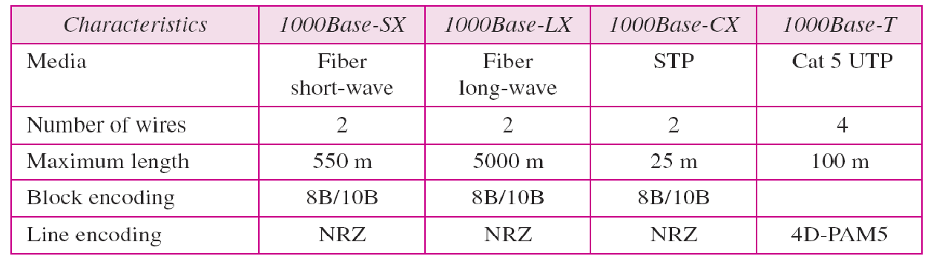
Table 13.3 Summary of Gigabit Ethernet implementations

Slide 40
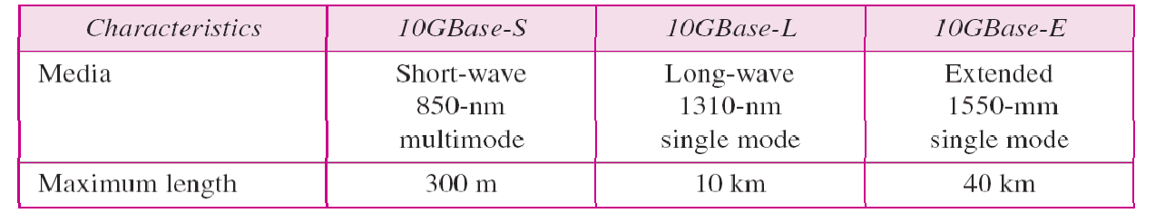
Table 13.4 Summary of Ten-Gigabit Ethernet implementations

